Slide 1

SANTHIRAM ENGINEERING COLLEGE NANDYAL (AUTONOMOUS)
DEPARTMENT OF ELECTRONICS AND COMMUNICATION ENGINEERING
BATCH NO : 18
Enhancement of Underwater Images Using Homomorphic Filtering and Optimal Background Quadtree Search
Project Guide: Project Associates:
Mr. S.Munawwar N.Divya (23X55A0415)
M. Tech. (Ph. D). S.B. Fazila Parveen (22X51A0478)
Associate professor C.Charitha (23X55A0404)
Department of ECE S.Athiya (22X51A0477)
P.Susmitha (22X51A0483)

Slide 2
CONTENT
Abstract
Introduction
Problem Statement
Objectives
Proposed Method
Flow Chart
Advantages & Disadvantages
Result & Conclusion
Comparison of Under Water Image Enhancement
References

Slide 3
ABSTRACT
Underwater images suffer from color distortion, low contrast, and blurred details due to light absorption and scattering.
The proposed multi-stage framework performs adaptive color correction, homomorphic filtering for contrast enhancement, and fusion to produce clearer, sharper images.
Results show improved visual quality and up to threefold better underwater target detection accuracy.

Slide 4
INTRODUCTION
Challenges in Underwater Imaging :
Underwater optical imaging is widely used in marine exploration, biological observation, environmental monitoring, and robotic navigation due to its high spatial resolution and speed.
Suspended particles in water cause light scattering and absorption, leading to reduced visibility and low contrast.
Wavelength-dependent attenuation removes red tones first, resulting in blue/green color dominance.
These distortions degrade image quality and affect vision-based tasks such as inspection, tracking, mapping, and navigation.
Hence, effective underwater image enhancement is essential for reliable visual perception.

Slide 5
Existing Methods and Motivation
Traditional methods: Contrast enhancement, histogram equalization, white balancing, homomorphic filtering, Retinex-based models, and multi-scale fusion to improve illumination and details.
Deep learning approaches: CNNs, attention mechanisms, adversarial learning, and multi-stage networks for color restoration, texture enhancement, and noise reduction.
Physical prior-based methods: Use optical models, wavelength correction, luminance fusion, and polarization techniques for restoration.
Limitations include dependency on large datasets, parameter tuning complexity, and reduced performance in challenging conditions.
Therefore, a new multi-stage enhancement framework is proposed to correct color imbalance, improve contrast, and restore structural details effectively.

Slide 6
PROBLEM STATEMENT
Underwater images usually suffer from low visibility, color distortion, and poor contrast due to light absorption and scattering in water.
The attenuation of different wavelengths leads to loss of red color and dominance of blue/green tones, degrading the natural appearance of the scene.
These degradations reduce the performance of computer vision systems in tasks such as object detection, navigation, monitoring, and marine exploration.
Noise, haze effects, and reduced sharpness further limit the extraction of meaningful features from underwater images.
The combined effect of these distortions results in unreliable visual perception in complex underwater environments.
Therefore, an efficient enhancement technique is required to restore color balance, improve contrast, and preserve important structural details.

Slide 7
OBJECTIVES
The main objective of our project is:
The main objectives of the proposed work are:
To improve the visual quality of degraded underwater images.
To correct color imbalance caused by wavelength-dependent light attenuation.
To enhance image contrast and visibility using homomorphic filtering.
To identify optimal background light regions using a quadtree search method.
To preserve important structural details and edges in underwater images.
To produce images with better clarity and realistic colors for computer vision application

Slide 8
PROPOSED METHOD
The proposed method introduces a multi-stage underwater image enhancement framework that combines spatial and frequency-domain processing.
Optimal Background Quadtree Search
The input image is divided into smaller regions using a quadtree structure to identify the most suitable background region for accurate illumination estimation.
Color Recognition and Adaptive Compensation
The RGB channels are analyzed to detect color imbalance, and adaptive compensation is applied to correct color distortion.
Homomorphic Filtering
A frequency-domain homomorphic filter is applied to suppress low-frequency illumination components and enhance high-frequency structural details..
Residual FFT–ReLU Processing
Frequency-domain transformations are used to refine features and highlight important image structures.
Channel Attention and Multi-stage Feature Refinement
Important feature channels are emphasized while suppressing noise and irrelevant information.
Image Reconstruction and Fusion
Finally, the enhanced features are combined to produce a high-quality underwater image with improved color and contrast.

Slide 9
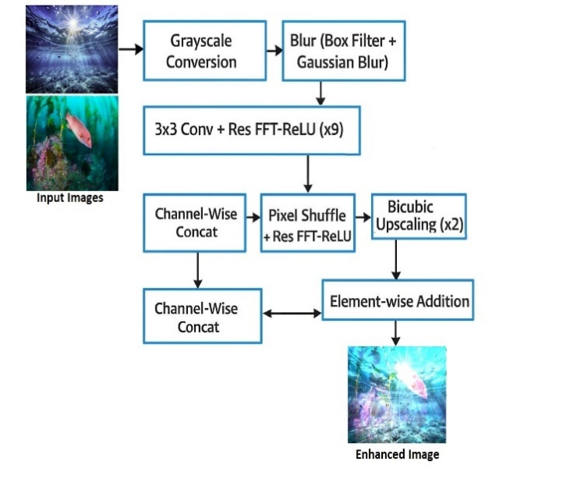
FLOW CHART :

Slide 10
RESULT & CONCLUSION
A hybrid image-processing pipeline has been developed through this work that is comprehensive and can process low-light RGB images. The pipeline performs the classical methods of spatial filtering and frequency-domain processing together with deep-learning-inspired operations.
The system utilizes a combination of blur-based smoothing, Gaussian denoising, and Laplacian edge extraction with iterative transformations of FFT-ReLU for the purpose of noise suppression while the other way around for boosting the salient structural features.
The feature representation is further refined by the use of max-pooling, batch normalization, and channel-attention modules, thus enabling robust enhancement even when the illumination is severely degraded. The last stage of bicubic interpolation reconstructs a high-resolution output where transitions are smooth and visual clarity is improved.
The experiments conducted proved that gradually through the stages the pipeline has been proposed to be able to contrast, sharpness, and detail preservation improvement, in addition, it has been outperforming conventional single-stage enhancement techniques inseparably by utilizing the complementary strengths of both spatial and frequency-domain.

Slide 11
Comparison of Underwater Image Enhancement Methods
Compared to traditional pixel-based methods, the proposed framework provides more adaptive color
compensation and better structural detail preservation, as it utilizes quadtree-based background estimation
instead of global intensity adjustments.
Compared to deep learning approaches, the proposed method does not require large-scale training
datasets or ground-truth images, making it more practical and computationally efficient for real-time underwater applications.
Compared to physics-based methods, the proposed technique avoids complex parameter tuning and
strict model assumptions while still effectively compensating for wavelength attenuation and uneven illumination.
Experimental evaluation on public underwater datasets demonstrates that the proposed method achieves
superior contrast improvement, more natural color restoration, and enhanced feature clarity,
leading to improved performance in downstream tasks such as underwater target detection.

Slide 12
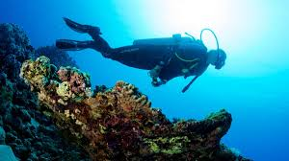
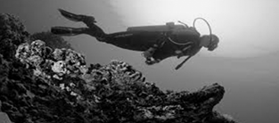
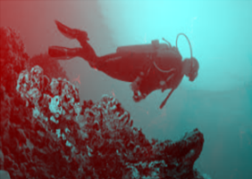
IMAGES FOR RESULT GENERATION

Slide 13
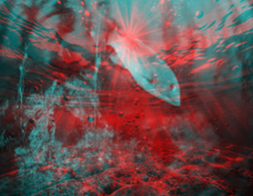
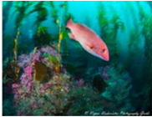
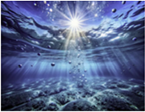
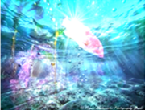
Output images

Slide 14
Advantages
Improves color balance by compensating wavelength-dependent color loss.
Enhances contrast and visibility in low-light underwater scenes.
Preserves fine structural details and edges in the image.
Reduces noise and haze effects caused by underwater scattering.
Produces more natural and visually pleasing images.
Improves feature extraction accuracy for underwater object detection.
Combines spatial-domain and frequency-domain processing, making the system more robust.

Slide 15
DISADVANTAGES
Existing underwater image enhancement techniques have several limitations:
Traditional pixel-based methods often lead to over-enhancement or loss of fine details.
Some techniques create artifacts such as halos and noise amplification.
Deep learning approaches require large datasets, which are limited for underwater environments.
Physical model-based methods require accurate environmental parameters, which are difficult to estimate in real underwater conditions.
Many methods fail to simultaneously correct color distortion and improve contrast effectively.

Slide 16
REFERENCES
[1] D. Xiang et al., “Attenuated color channel adaptive correction and bilateral weight fusion for underwater image enhancement,” Opt. Lasers Eng., vol. 184, p. 108575, 2025.
[2] B. Li et al., “Cascaded frameworks in underwater optical image restoration,” Inf. Fusion, vol. 117, p. 102809, 2025.
[3] L. Hong et al., “CCM-Net: color compensation and coordinate attention guided underwater image enhancement with multi-scale feature aggregation,” Opt. Lasers Eng., vol. 184, p. 108590, 2025.
[4] W. Zhang et al., “Underwater image enhancement via weighted wavelet visual perception fusion,” IEEE Trans. Circuits Syst. Video Technol., vol. 34, no. 4, pp. 2469–2483, 2024.
E. Zhang, X. Li, Y. Huang, S. Xu, J. Tang, and H. Hu, “Underwater image enhancement via frequency and spatial domains fusion,” Optics and Lasers
in Engineering, vol. 186, 108826, 2025, doi: 10.1016/j.optlaseng.2025.108826..
[6] A. K. Mishra et al., “Fusion of multiscale gradient domain enhancement and gamma correction for underwater image/video enhancement,” Opt. Lasers Eng., vol. 178, p. 108154, 2024.
[7] C. Wang et al., “Rethinking underwater image restoration based on circularly polarized light,” Photonics, vol. 11, no. 8, 2024.

Slide 17
[8] H. Hu et al., “Enhancing underwater image via colour-cast correction and luminance fusion,” IEEE J. Ocean. Eng., vol. 49, no. 1, pp. 15–29, 2024.
[9] J. Deng et al., “Real-time underwater polarization imaging without relying on background,” Opt. Lasers Eng., vol. 169, p. 107721, 2023.
[10] W. D. Zhang et al., “Underwater image enhancement via piecewise color correction and dual prior optimized contrast enhancement,” IEEE Signal Process. Lett., vol. 30, pp. 229–233, 2023
[11] S. Munawwar and P. V. G. K. Rao, “Medical Image Fusion based on Multi-scale Decomposition using Hybrid Deep Learning Network Model,” Comput. Methods Biomech. Biomed. Eng.: Imaging Vis., 2023, doi:10.1080/21681163.2023.2215877.
[12] D. Liu et al., “Underwater image restoration via background light estimation and depth map optimization,” Opt. Express, vol. 30, no. 16, pp. 29099–29116, 2022.
[13] J. Y. Chiang and Y.-C. Chen, “Underwater image enhancement by wavelength compensation and dehazing,” IEEE Trans. Image Process., pp. 1756–1769, 2022 (latest reprint/republished).
[14] W. Zhang, L. Dong, and W. Xu, “Retinex-inspired color correction and detail-preserved fusion for underwater image enhancement,” Comput. Electron. Agric., vol. 192, p. 106585, 2022.

Slide 18
Thank You…

